Slide 1
Stock Price Prediction
Course: Business Analytics
Instructor: Hrant Davtyan
Student: Arusyak Hakobyan

Slide 2
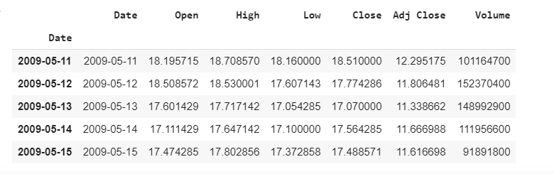
Problem
Find the closing price of the stock

Slide 3
Solution

Slide 4
Methodological approach
Moving average
Autoregressive integrated moving average(ARIMA)
Long short-term memory(LSTM)

Slide 5
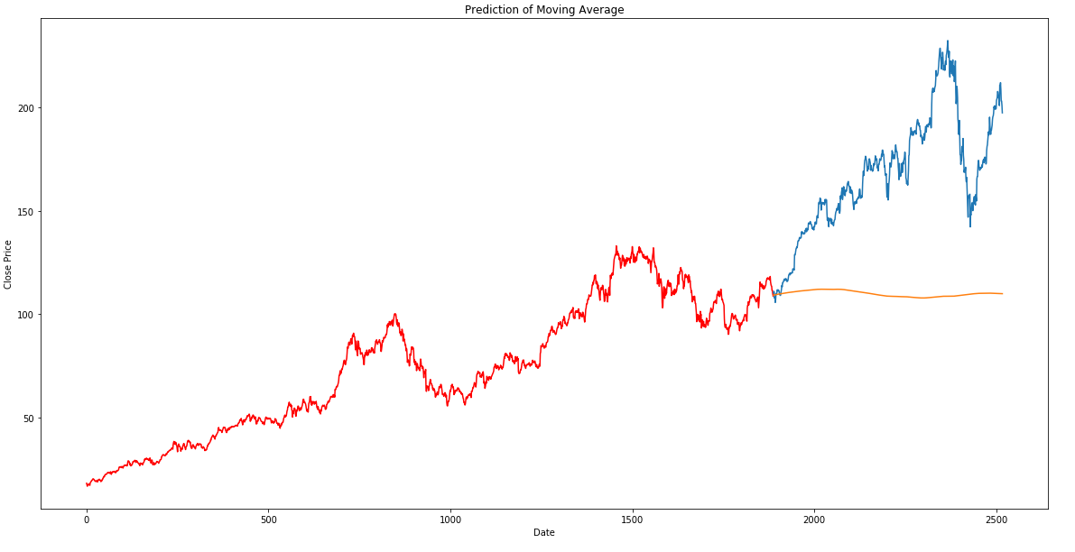
Results - Moving Average

Slide 6
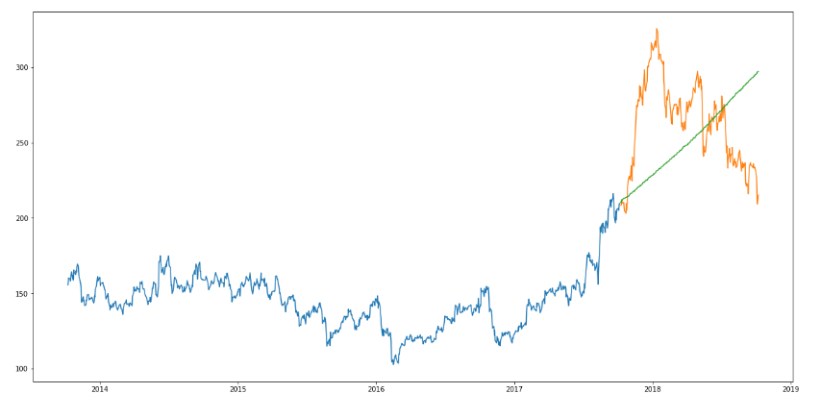
Results - ARIMA

Slide 7
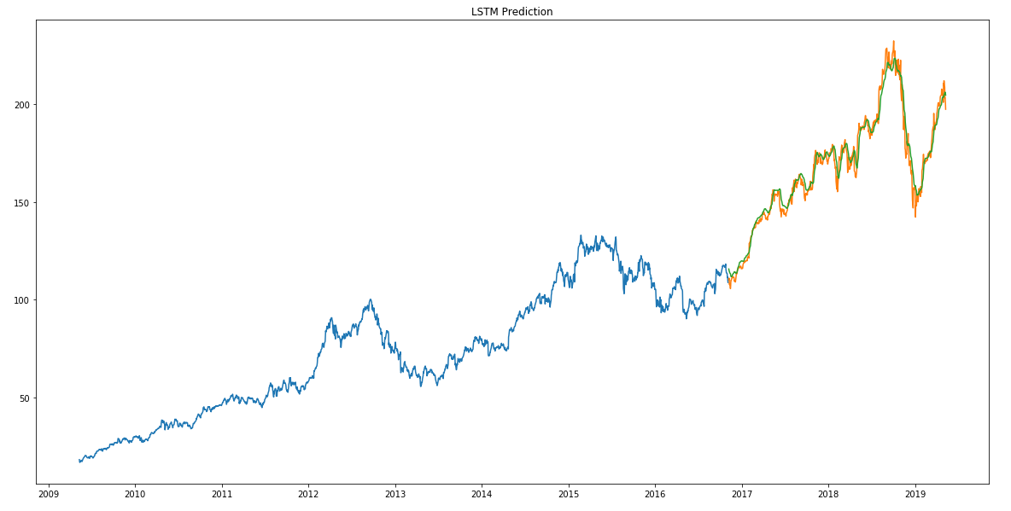
Results - LSTM

Slide 8
Conclusion
RMSE
Moving Average - 60
ARIMA - 40
LSTM - 5
Further Research
CNNs

Slide 9
Thank You!

